Slide 1
Customer Retention

Slide 2
E-retail factors for customer activation and retention: A case study from Indian e-commerce customers
Customer satisfaction has emerged as one of the most important factors that guarantee the success of online store; it has been posited as a key stimulant of purchase, repurchase intentions and customer loyalty. A comprehensive review of the literature, theories and models have been carried out to propose the models for customer activation and customer retention. Five major factors that contributed to the success of an e-commerce store have been identified as: service quality, system quality, information quality, trust and net benefit. The research furthermore investigated the factors that influence the online customers repeat purchase intention. The combination of both utilitarian value and hedonistic values are needed to affect the repeat purchase intention (loyalty) positively. The data is collected from the Indian online shoppers. Results indicate the e-retail success factors, which are very much critical for customer satisfaction.

Slide 3

Customer Recommention
A customer only recommends a site to visit when he/she get satisfaction from site User Interface, Best content, Fastness etc and shows engagement towards site i.e Retention.

Slide 4
We have observe a dataset about customer recommendation towards site i.e Retention.
Let’s starts with Dataset
1

Slide 5
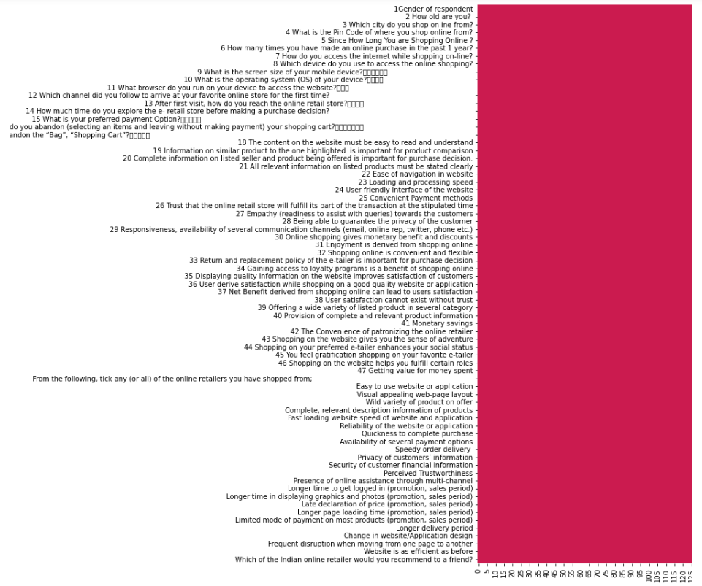
Checking observations columns and Null values of the dataset.

Slide 6
Shape of the Dataset
269 Rows
71 Columns
Dataset having so many Unique values as below:

Slide 7
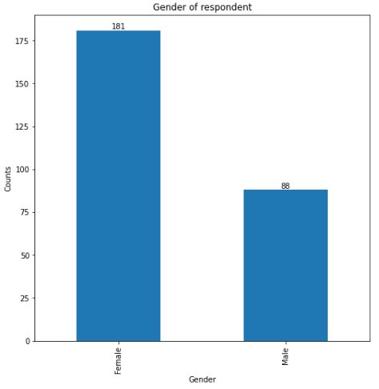
Checking dataset: Gender of respondent

Slide 8
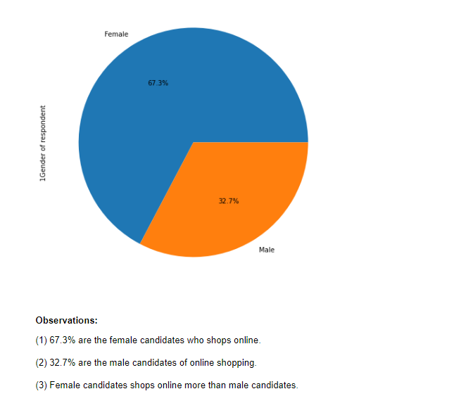

Slide 9
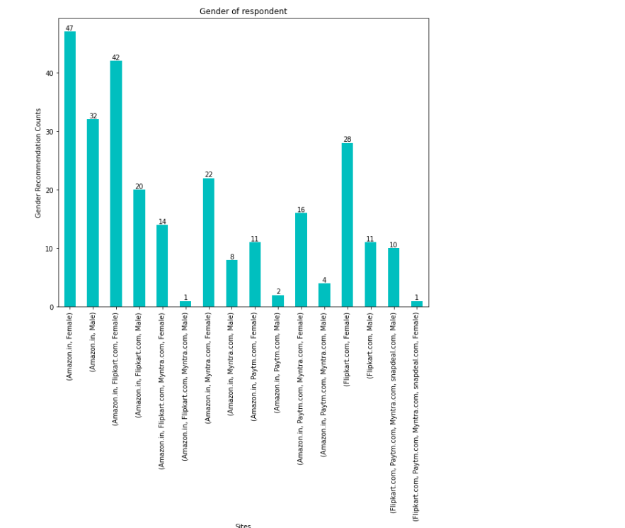
Gender Respondent towards sites

Slide 10
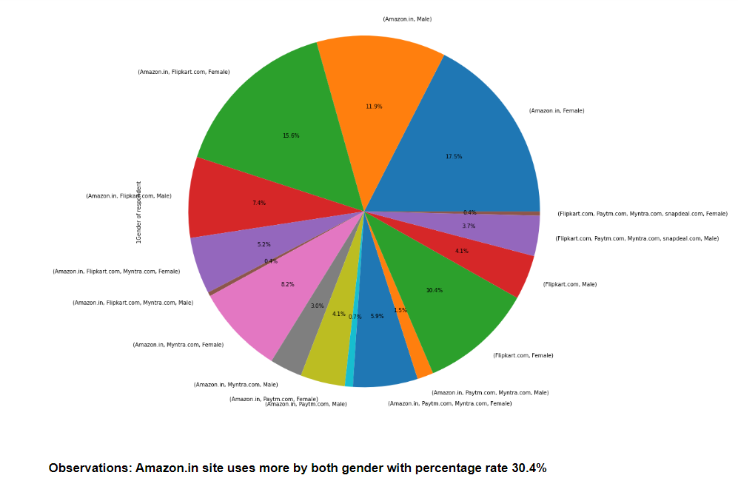

Slide 11

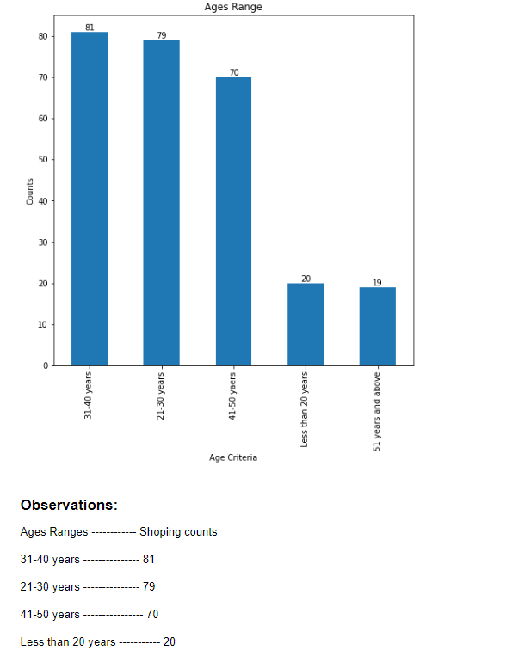
Ages Ranges toward site recommendations

Slide 12
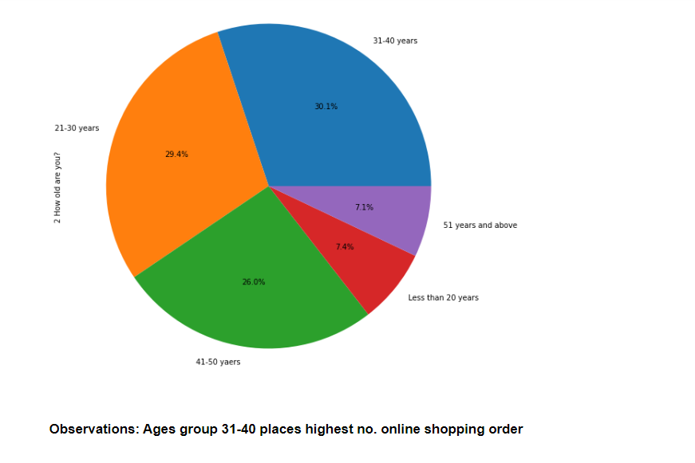

Slide 13
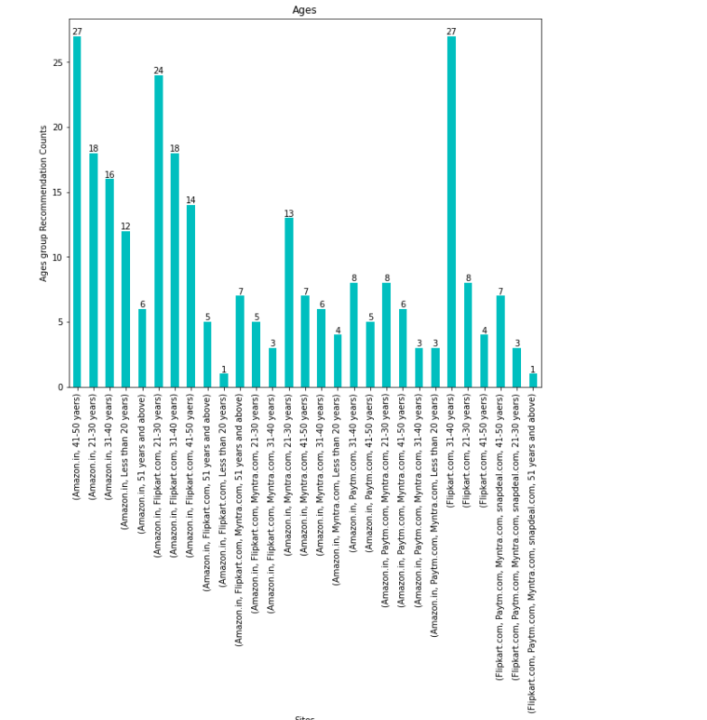

Slide 14
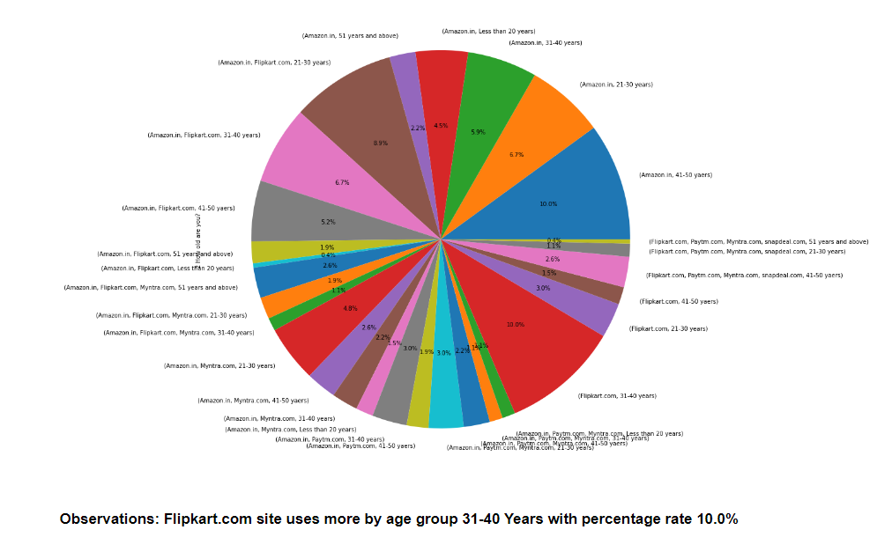

Slide 15

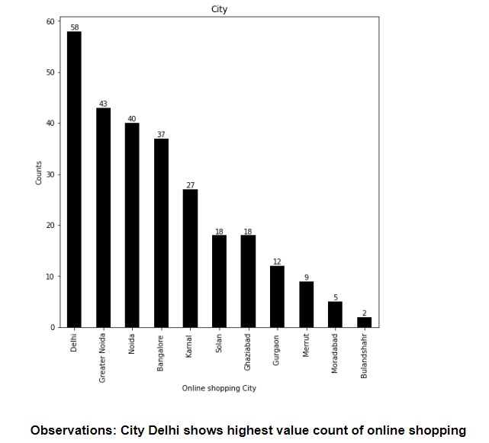

Slide 16

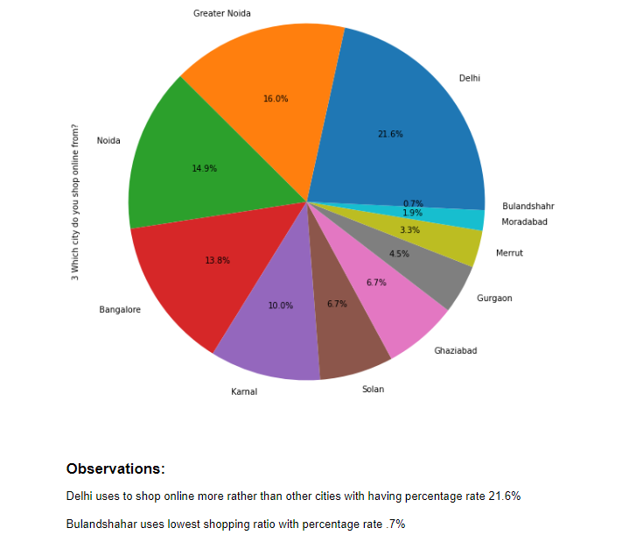

Slide 17

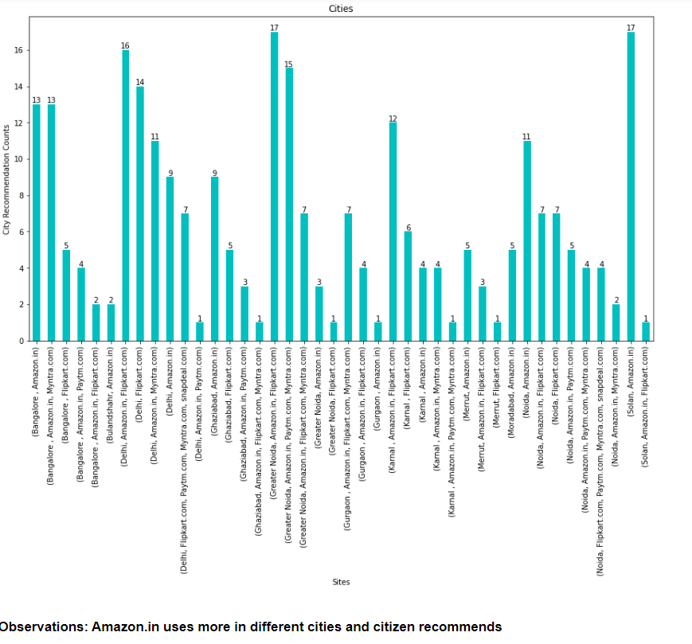

Slide 18
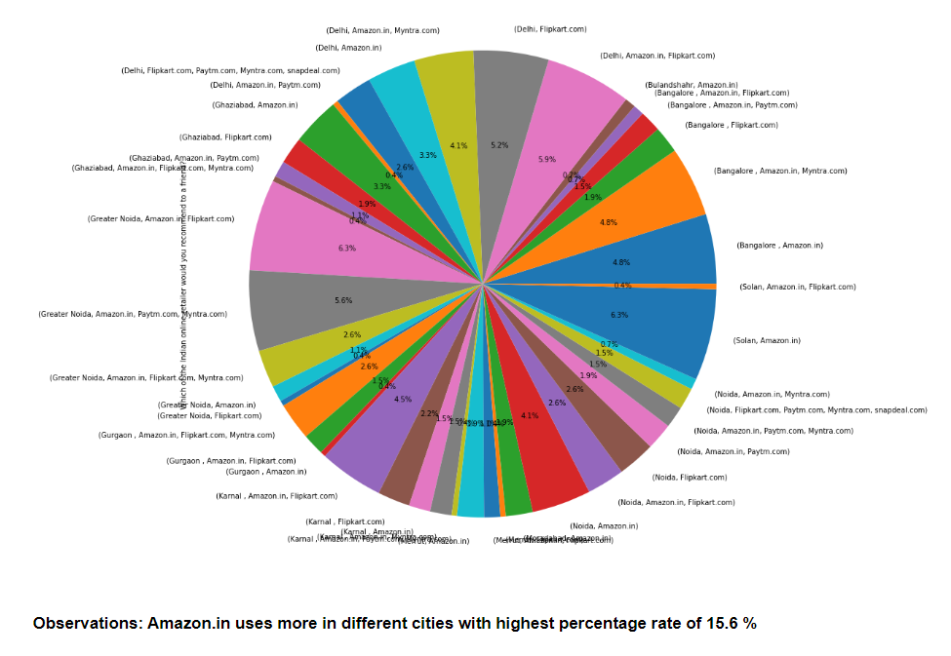

Slide 19

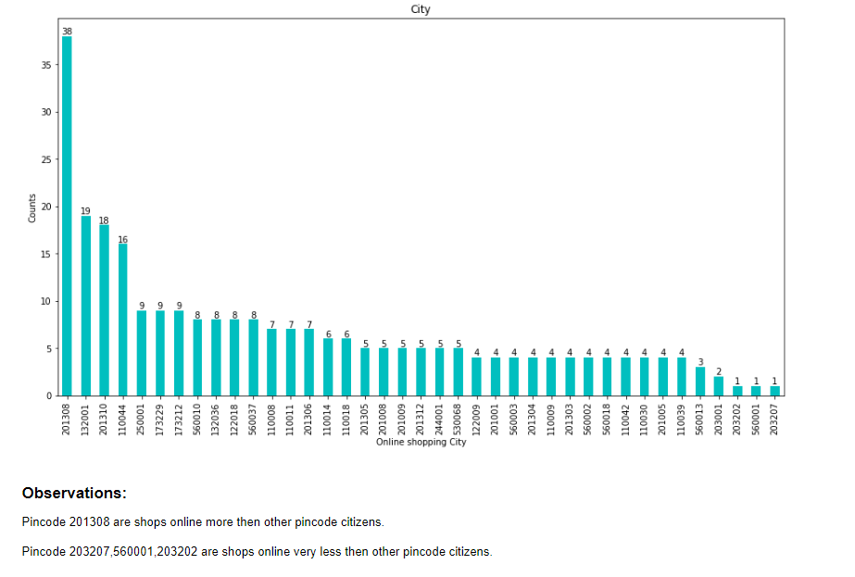

Slide 20
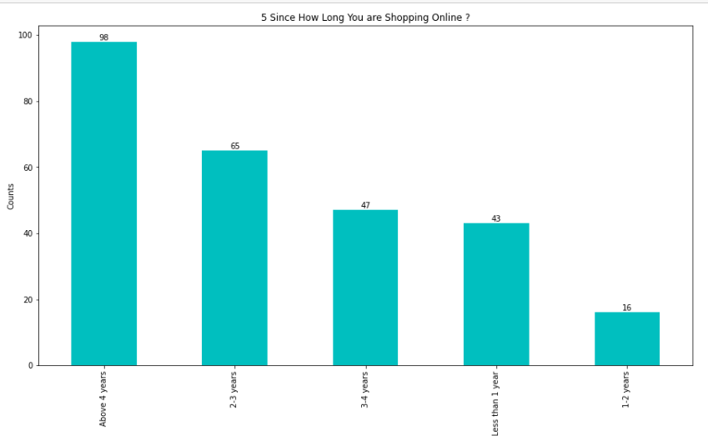

Slide 21
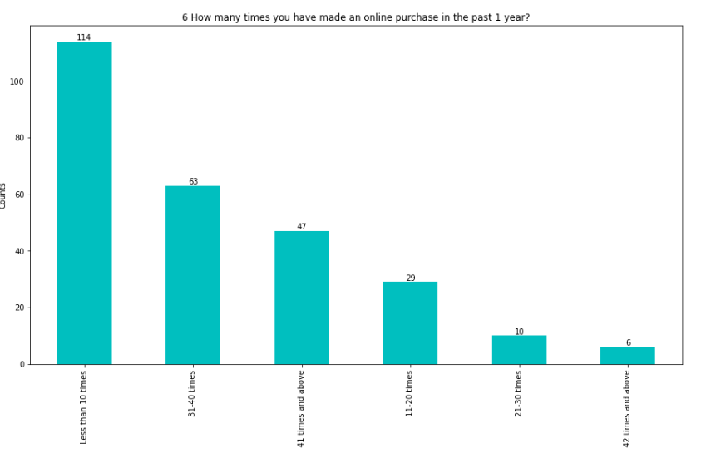

Slide 22
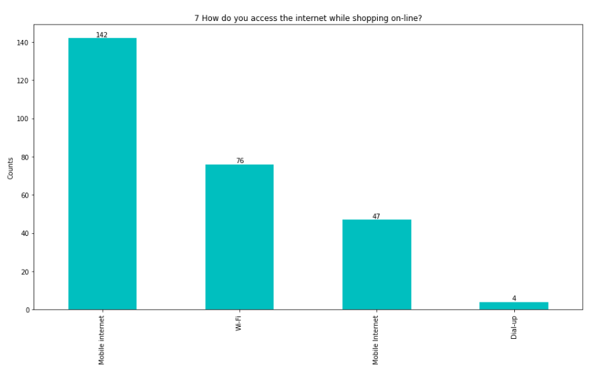

Slide 23
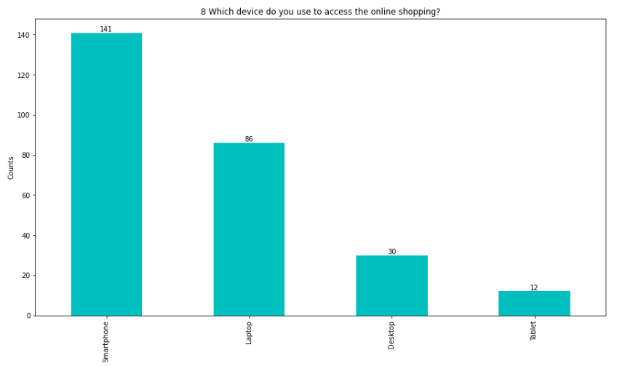

Slide 24
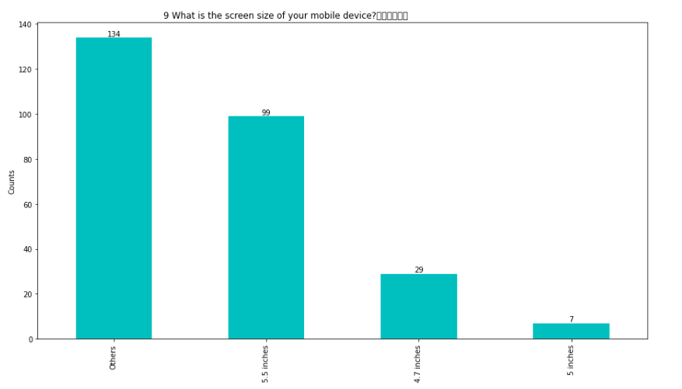

Slide 25
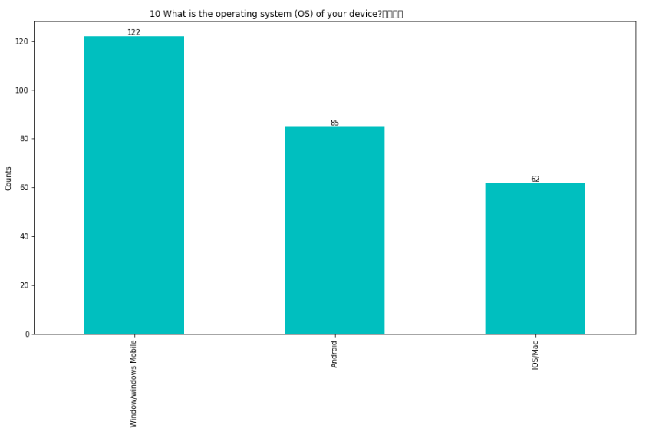

Slide 26
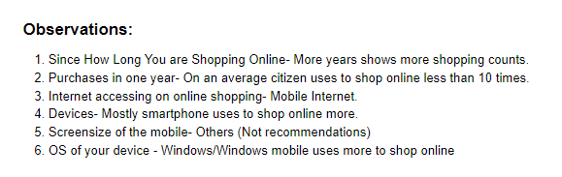
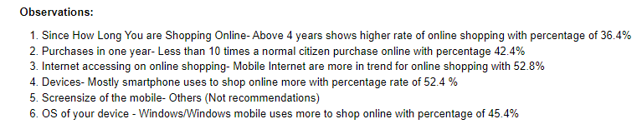

Slide 27
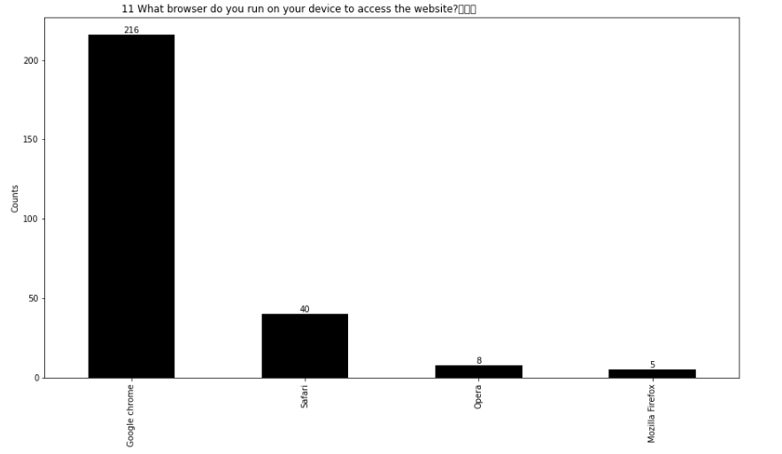

Slide 28
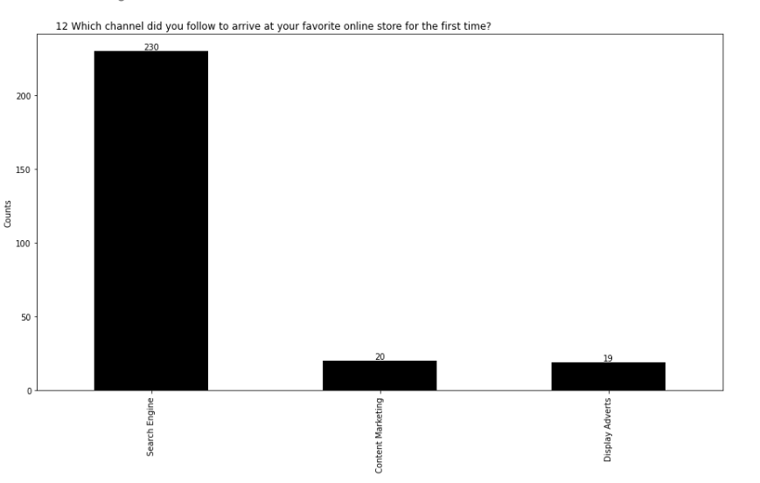

Slide 29
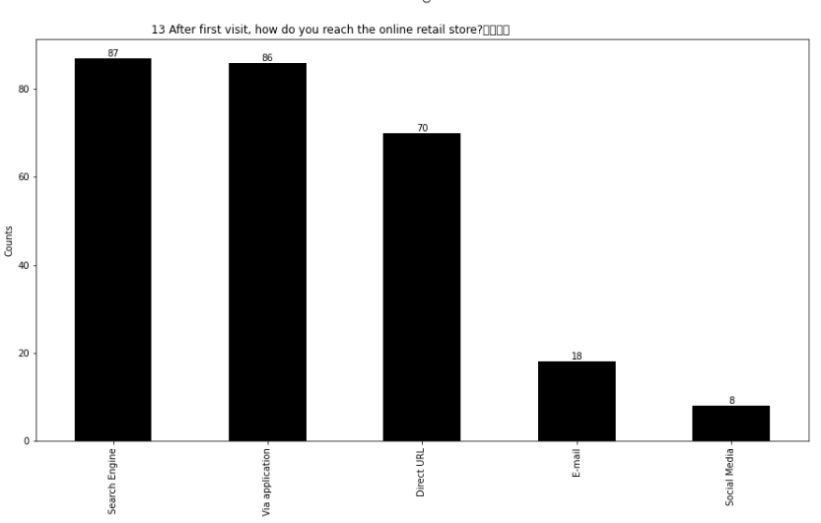

Slide 30
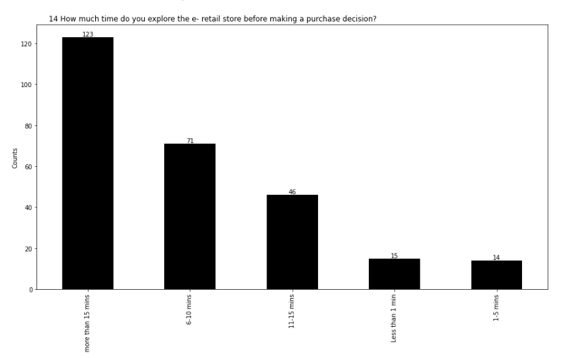

Slide 31
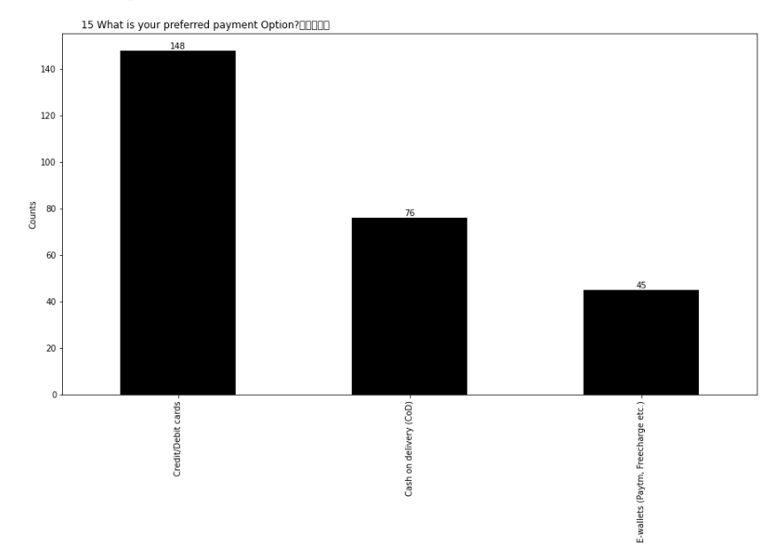

Slide 32
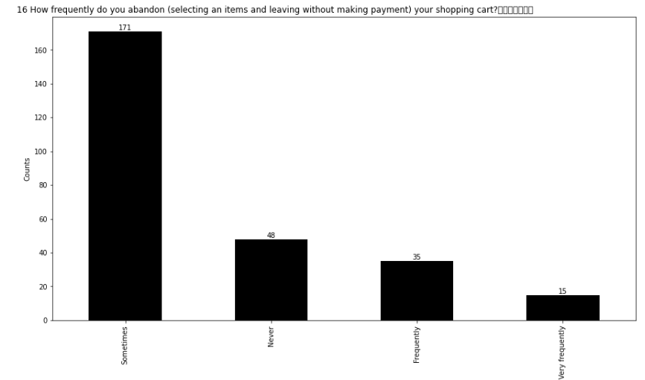

Slide 33
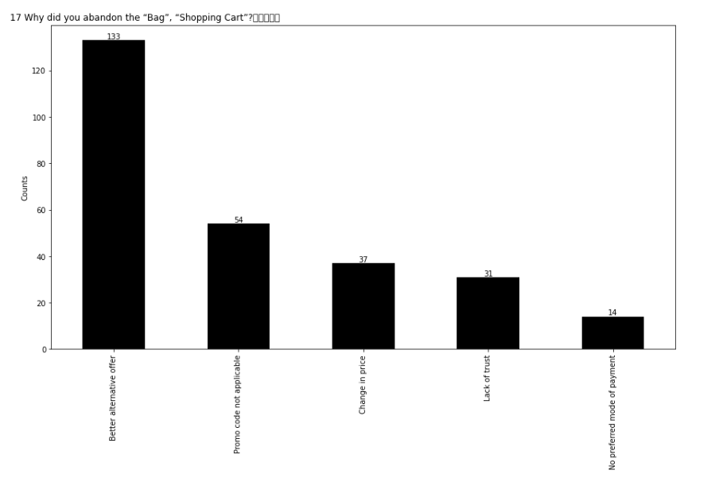

Slide 34
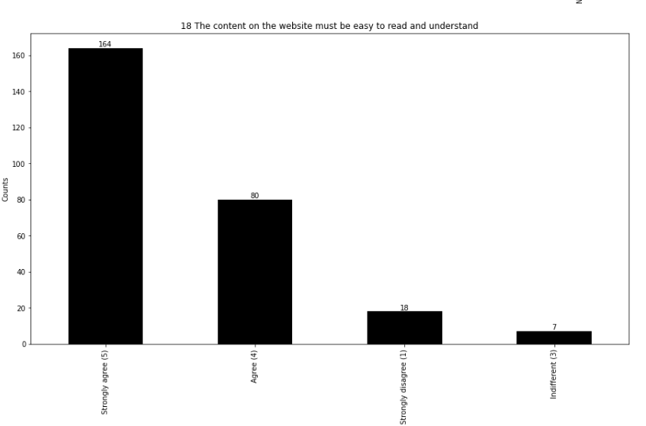

Slide 35
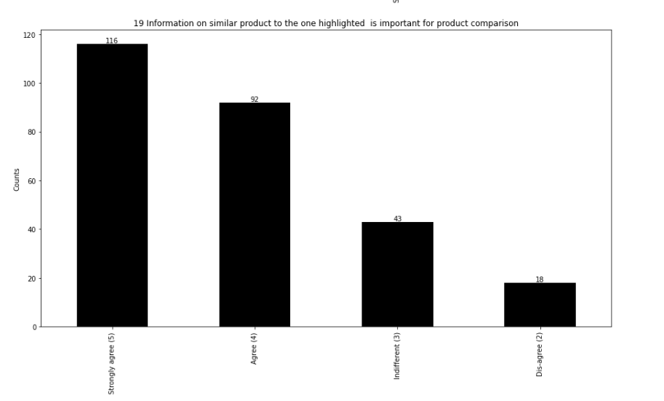

Slide 36
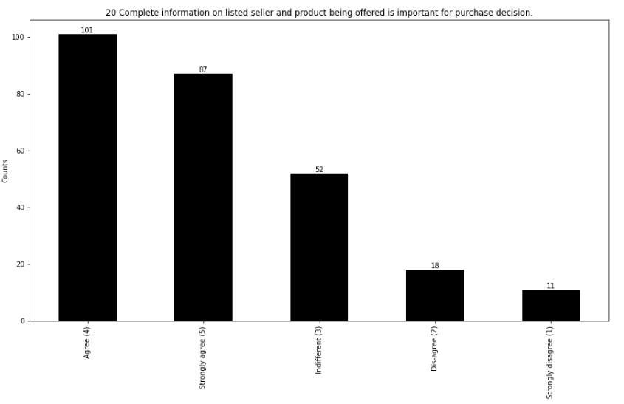

Slide 37
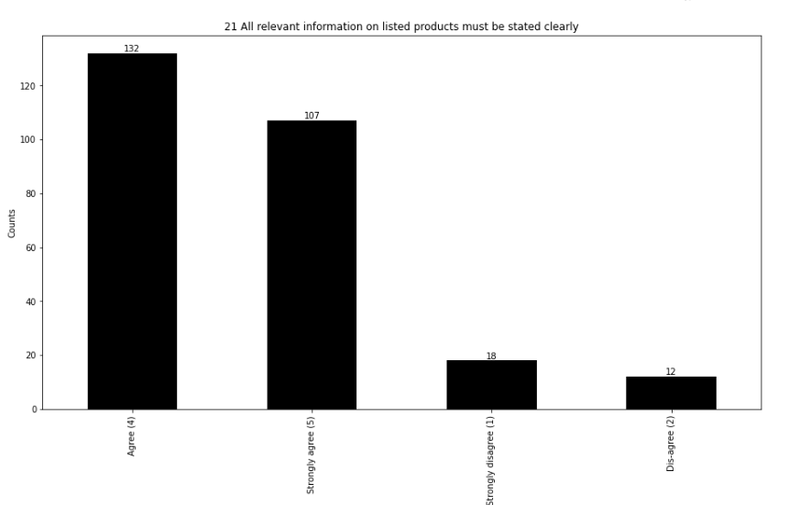

Slide 38
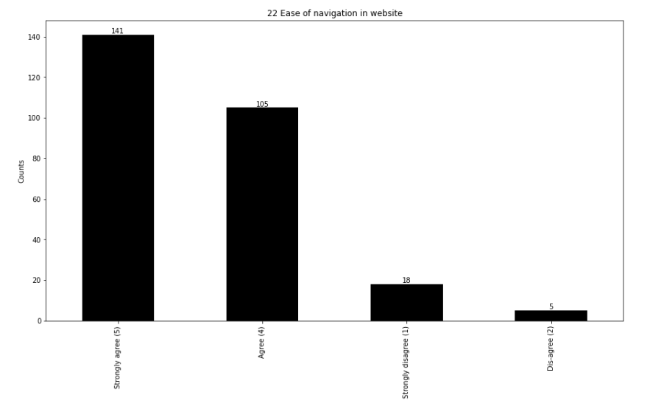

Slide 39
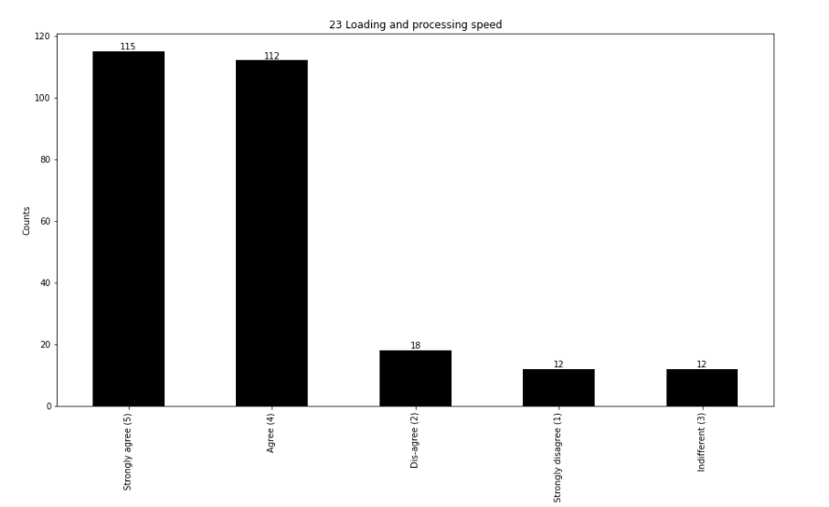

Slide 40
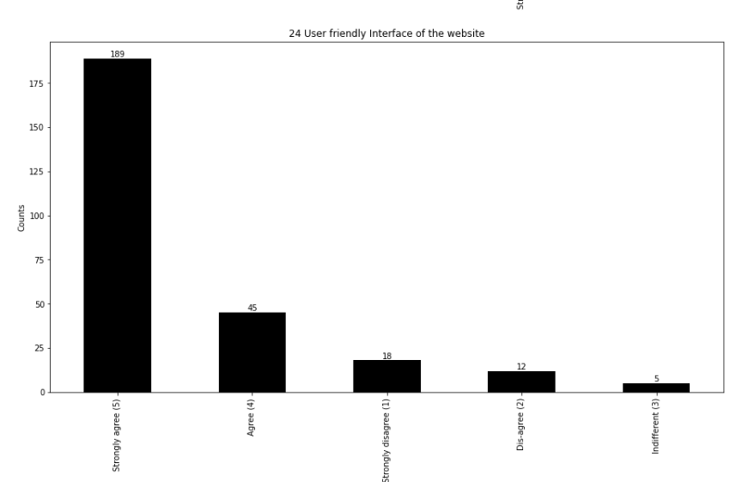

Slide 41
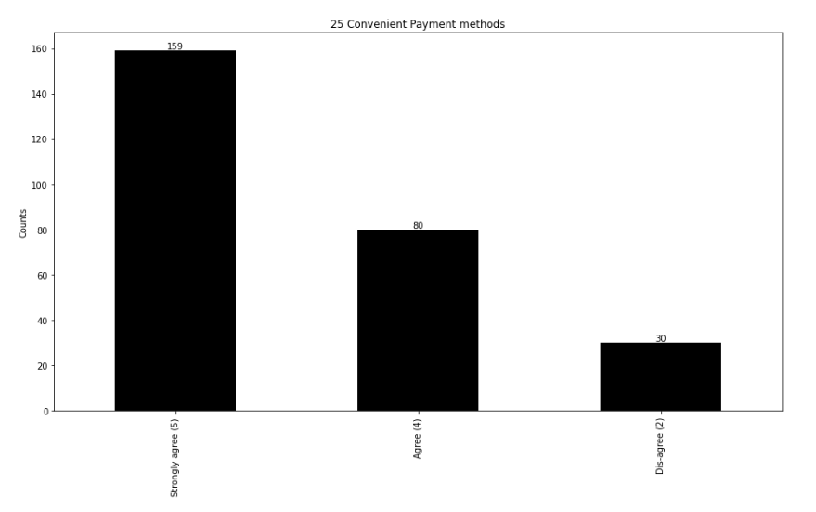

Slide 42
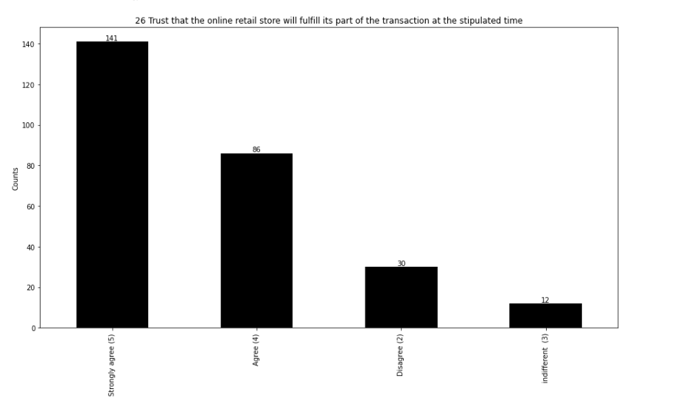

Slide 43
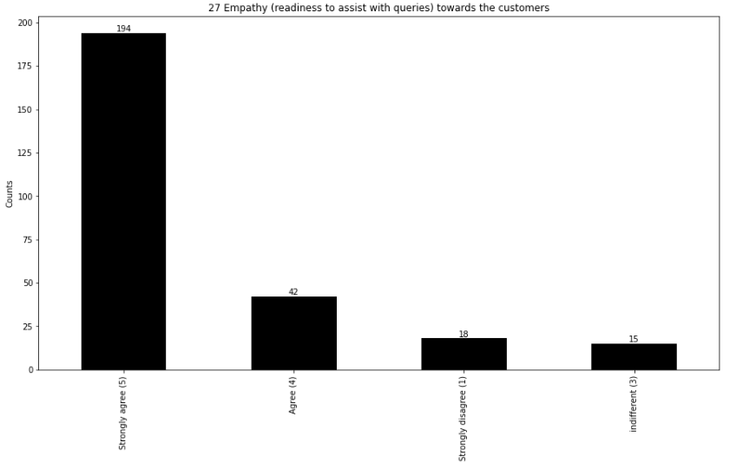

Slide 44
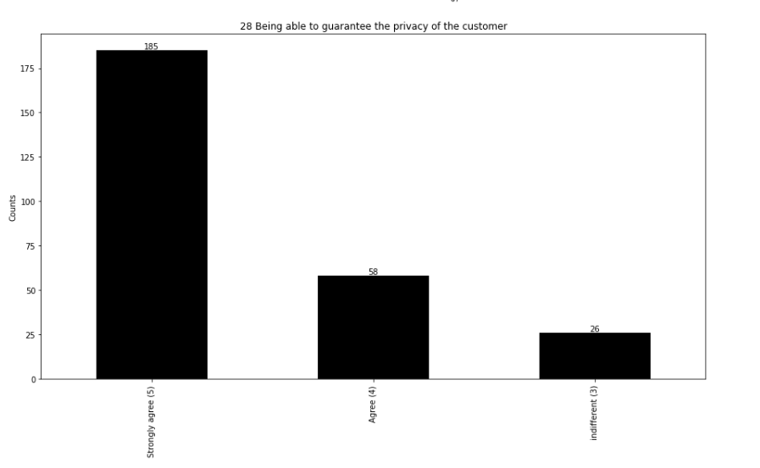

Slide 45
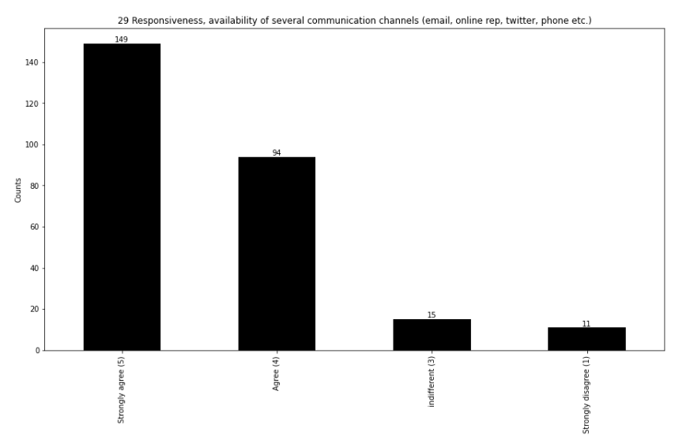

Slide 46
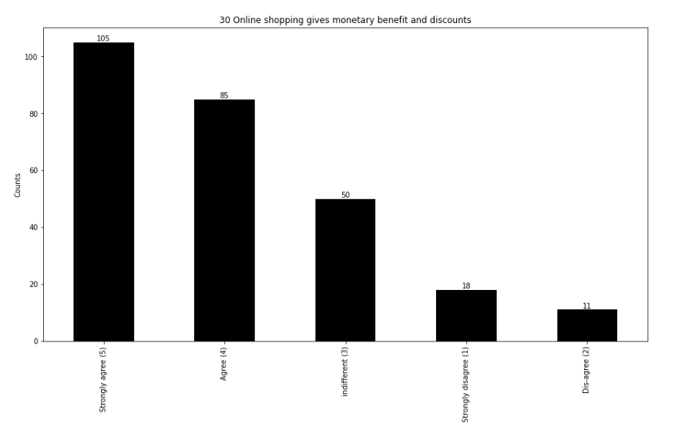

Slide 47
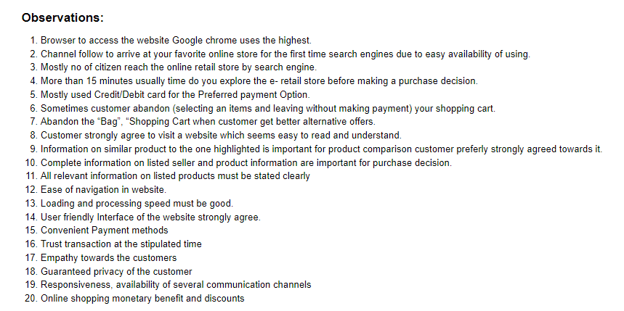

Slide 48
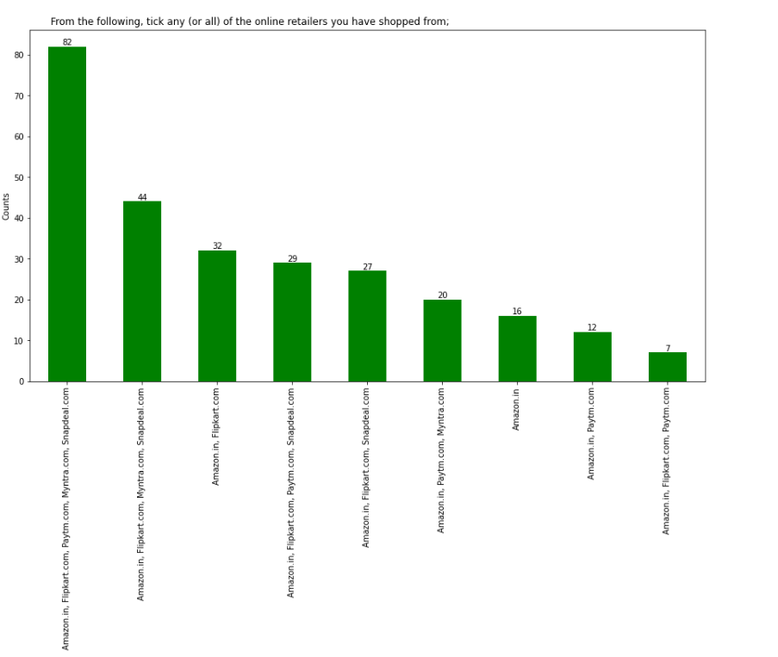
Some of the Dataset Columns having Agree, Disagrees values.
Hence we skipped as per Human Common Sense.
Rest Dataset are as below:

Slide 49
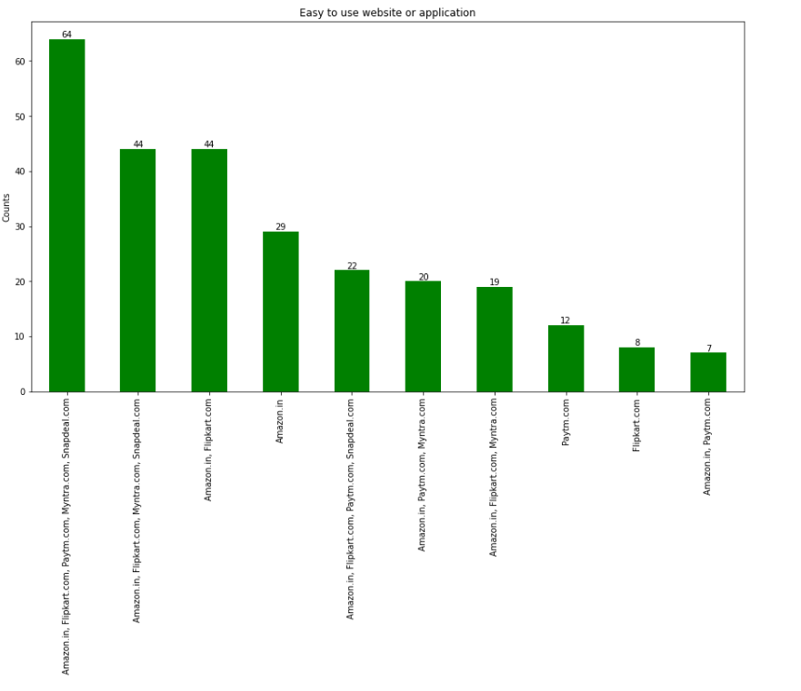

Slide 50
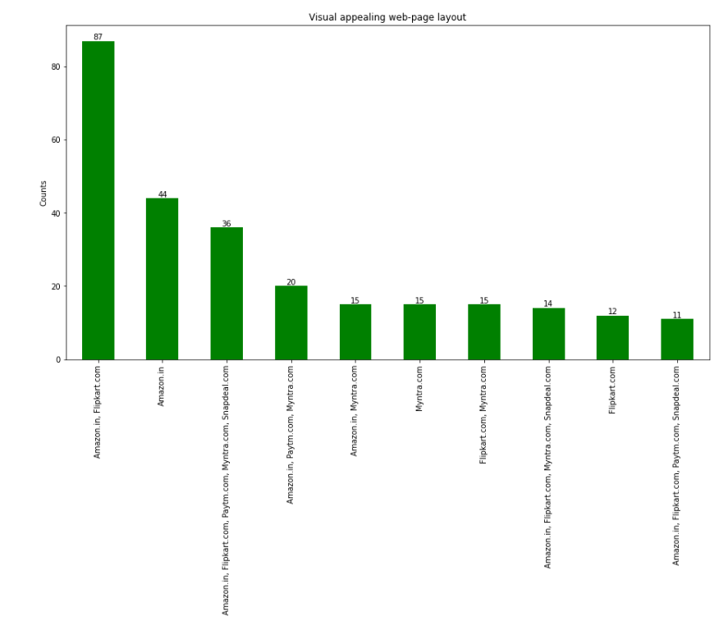

Slide 51
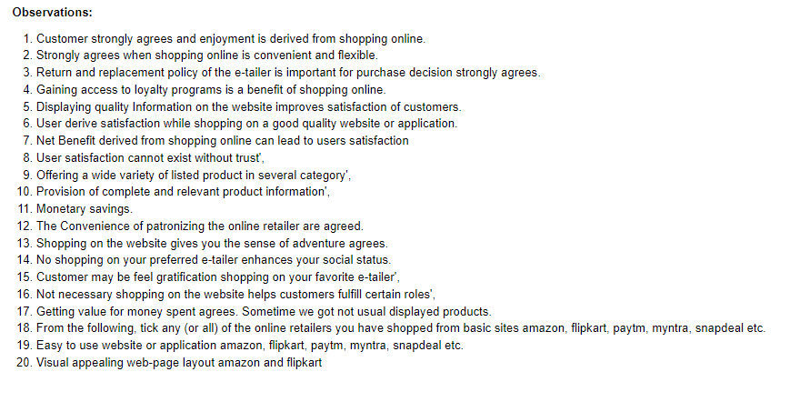

Slide 52
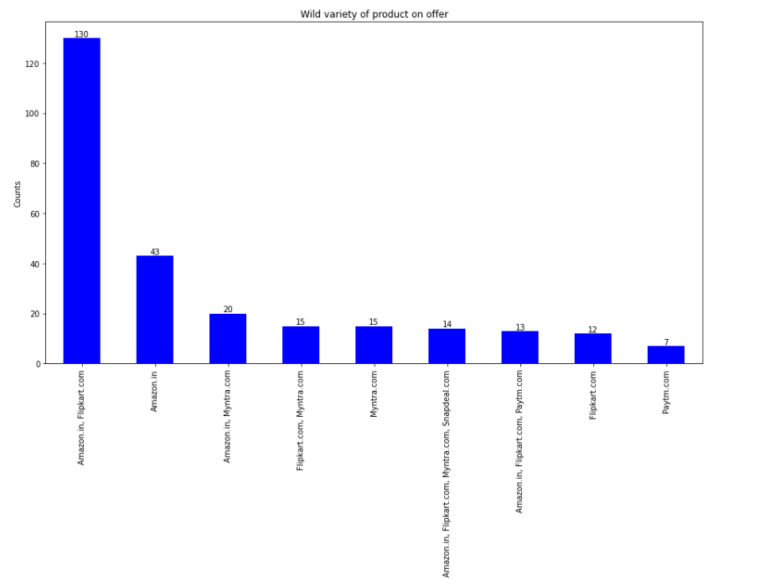

Slide 53
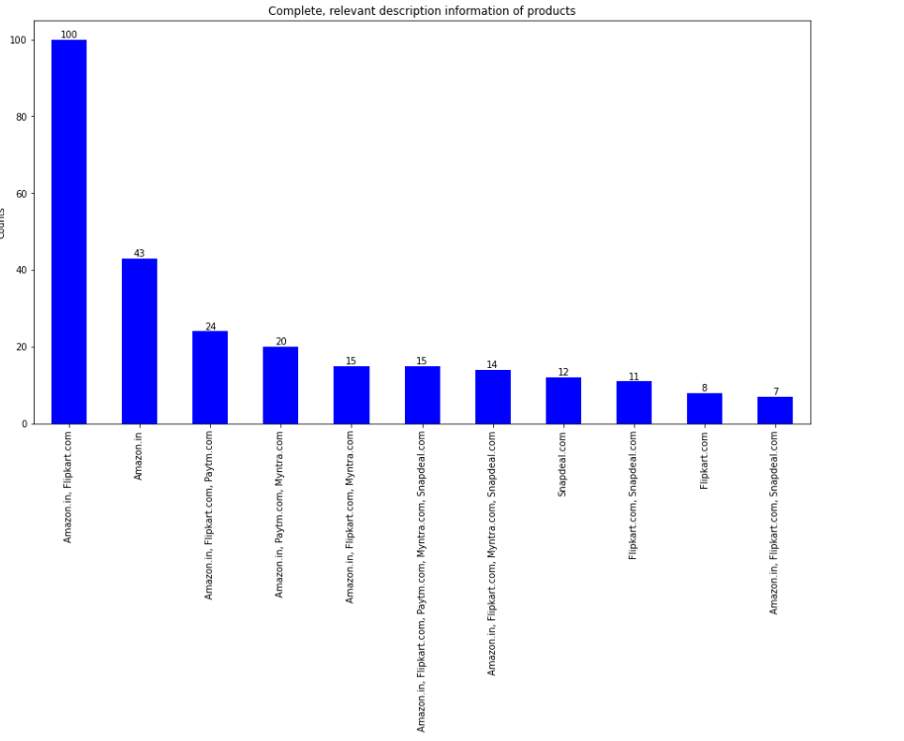

Slide 54
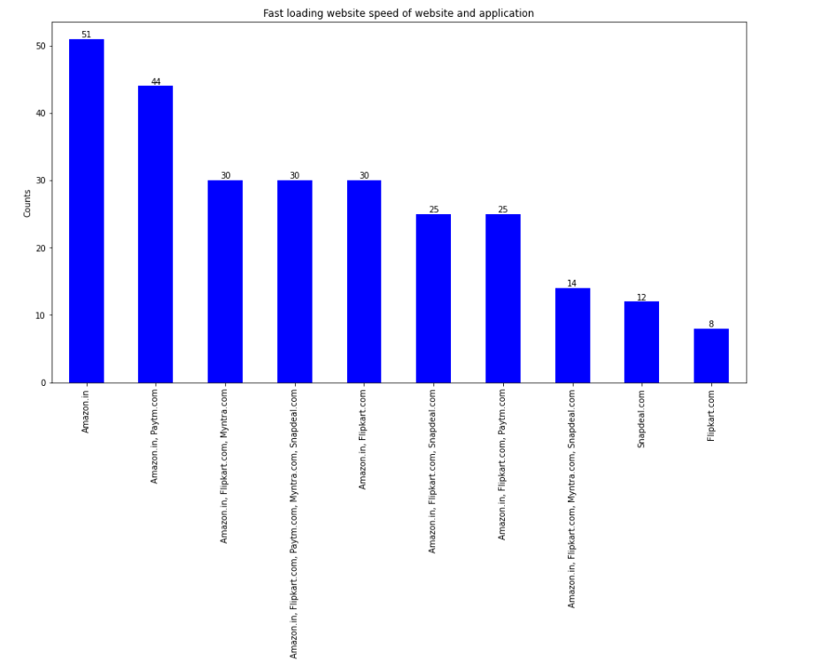

Slide 55


Slide 56


Slide 57


Slide 58


Slide 59


Slide 60


Slide 61


Slide 62


Slide 63


Slide 64


Slide 65


Slide 66


Slide 67


Slide 68


Slide 69


Slide 70


Slide 71


Slide 72


Slide 73


Slide 74
Thanks

